Slide 1
HBCS Data Insight
Mak Hei Ming

Slide 2
Survey Feedback
Elderly respondents may not understand various terms related to antibiotic resistance and might have limited awareness of these concepts. They may claim they do not have certain conditions when, in fact, they do.​
Elderly individuals may find it challenging to fully understand their dietary requirements; for instance, they might be following a diabetes diet without realizing it.​
For Part 11, it would be beneficial to provide a clear definition of “friends.”​
For Part 9 regarding eyesight, if a person claims they see normally but is wearing glasses, it would be important to confirm whether this indicates that their eyesight is actually diminished.​
For Part 10 regarding eating, if a person claims they eat normally but requires dentures, it is important to confirm whether this suggests that their eating ability is actually diminished.​
For the IADL, it may be difficult to differentiate between scores of 2 and 3.

Slide 3
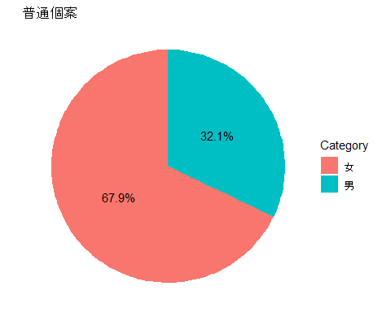
Demographics (Baseline = 672)
##
## Attaching package: 'dplyr'
## The following objects are masked from 'package:stats':
##
## filter, lag
## The following objects are masked from 'package:base':
##
## intersect, setdiff, setequal, union
## Warning: package 'ggplot2' was built under R version 4.5.2
## # A tibble: 672 × 638
## num A1 A2a A2b A2c A3a A3b A3c B1 B2 B3 B4a B4b
## <int> <chr> <int> <int> <int> <int> <int> <int> <chr> <chr> <int> <int> <int>
## 1 631 EHC/… 2023 11 7 2025 5 7 " 陳駿… CHAN… 1 1938 1
## 2 58 EHC/… 2020 6 22 2024 6 17 "任煥娥… Yam … 2 1936 1
## 3 266 HSS/… 2024 12 27 2024 12 27 "伍瑞鳳… Ng S… 2 1943 11
## 4 59 EHC/… 2019 10 19 2024 6 27 "何亞蘭… Ho A… 2 1945 1
## 5 617 IHF/… 2025 6 27 2025 6 27 "余月容… YU Y… 2 1946 10
## 6 592 HSS/… 2025 5 28 2025 5 28 "冼家偉… Sin … 1 1929 1
## 7 26 HSS/… 2024 8 22 2024 8 22 "劉錞清… Lau … 1 1940 10
## 8 281 HSS/… 2010 9 14 2025 1 3 "古楊喜… Kuo … 1 1942 5
## 9 126 EHC/… 2019 10 21 2024 6 25 "吳鳳"… Ng F… 2 1933 1
## 10 628 EHC/… 2023 6 13 2025 5 16 "周猷光… CHOW… 1 1937 1
## # ℹ 662 more rows
## # ℹ 625 more variables: B4c <int>, B5 <int>, B6 <int>, B8a <chr>, B8b <chr>,
## # B8c <chr>, B11 <int>, B12 <int>, B12a <chr>, B13 <int>, B13a <chr>,
## # B14 <chr>, B15 <int>, B16 <int>, B16a <int>, B17 <int>, C1 <int>,
## # C1a <chr>, C2 <int>, C3 <int>, C3a <chr>, C4 <int>, C4a <int>, C5 <int>,
## # C6a <int>, C6b <int>, C6c <int>, C6d <int>, C6e <int>, C6e1 <chr>,
## # C7 <int>, C7a <int>, C7b <int>, C8 <int>, C8a <int>, C8b <int>, …
## # A tibble: 3 × 2
## A1_short Frequency
## <chr> <int>
## 1 HSS 408
## 2 EHC 180
## 3 IHF 84
## # A tibble: 7 × 3
## A1_short Gender Frequency
## <chr> <int> <int>
## 1 EHC 2 135
## 2 EHC 1 45
## 3 HSS 2 269
## 4 HSS 1 131
## 5 HSS 0 8
## 6 IHF 2 56
## 7 IHF 1 28

Slide 4
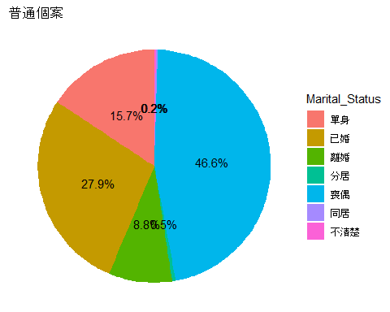
## # A tibble: 672 × 638
## num A1 A2a A2b A2c A3a A3b A3c B1 B2 B3 B4a B4b
## <int> <chr> <int> <int> <int> <int> <int> <int> <chr> <chr> <int> <int> <int>
## 1 631 EHC/… 2023 11 7 2025 5 7 " 陳駿… CHAN… 1 1938 1
## 2 58 EHC/… 2020 6 22 2024 6 17 "任煥娥… Yam … 2 1936 1
## 3 266 HSS/… 2024 12 27 2024 12 27 "伍瑞鳳… Ng S… 2 1943 11
## 4 59 EHC/… 2019 10 19 2024 6 27 "何亞蘭… Ho A… 2 1945 1
## 5 617 IHF/… 2025 6 27 2025 6 27 "余月容… YU Y… 2 1946 10
## 6 592 HSS/… 2025 5 28 2025 5 28 "冼家偉… Sin … 1 1929 1
## 7 26 HSS/… 2024 8 22 2024 8 22 "劉錞清… Lau … 1 1940 10
## 8 281 HSS/… 2010 9 14 2025 1 3 "古楊喜… Kuo … 1 1942 5
## 9 126 EHC/… 2019 10 21 2024 6 25 "吳鳳"… Ng F… 2 1933 1
## 10 628 EHC/… 2023 6 13 2025 5 16 "周猷光… CHOW… 1 1937 1
## # ℹ 662 more rows
## # ℹ 625 more variables: B4c <int>, B5 <int>, B6 <int>, B8a <chr>, B8b <chr>,
## # B8c <chr>, B11 <int>, B12 <int>, B12a <chr>, B13 <int>, B13a <chr>,
## # B14 <chr>, B15 <int>, B16 <int>, B16a <int>, B17 <int>, C1 <int>,
## # C1a <chr>, C2 <int>, C3 <int>, C3a <chr>, C4 <int>, C4a <int>, C5 <int>,
## # C6a <int>, C6b <int>, C6c <int>, C6d <int>, C6e <int>, C6e1 <chr>,
## # C7 <int>, C7a <int>, C7b <int>, C8 <int>, C8a <int>, C8b <int>, …
## # A tibble: 17 × 3
## A1_short Marital_Status Frequency
## <chr> <int> <int>
## 1 EHC 5 105
## 2 EHC 2 63
## 3 EHC 3 5
## 4 EHC 1 4
## 5 EHC 4 3
## 6 HSS 5 190
## 7 HSS 2 114
## 8 HSS 1 64
## 9 HSS 3 36
## 10 HSS 4 2
## 11 HSS 6 1
## 12 HSS 7 1
## 13 IHF 5 42
## 14 IHF 2 33
## 15 IHF 1 5
## 16 IHF 3 3
## 17 IHF 4 1

Slide 5
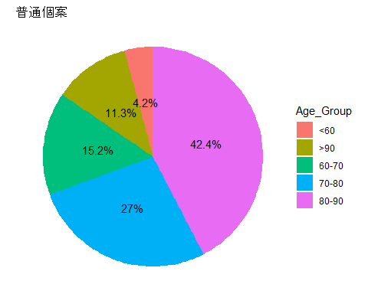
## # A tibble: 672 × 638
## num A1 A2a A2b A2c A3a A3b A3c B1 B2 B3 B4a B4b
## <int> <chr> <int> <int> <int> <int> <int> <int> <chr> <chr> <int> <int> <int>
## 1 631 EHC/… 2023 11 7 2025 5 7 " 陳駿… CHAN… 1 1938 1
## 2 58 EHC/… 2020 6 22 2024 6 17 "任煥娥… Yam … 2 1936 1
## 3 266 HSS/… 2024 12 27 2024 12 27 "伍瑞鳳… Ng S… 2 1943 11
## 4 59 EHC/… 2019 10 19 2024 6 27 "何亞蘭… Ho A… 2 1945 1
## 5 617 IHF/… 2025 6 27 2025 6 27 "余月容… YU Y… 2 1946 10
## 6 592 HSS/… 2025 5 28 2025 5 28 "冼家偉… Sin … 1 1929 1
## 7 26 HSS/… 2024 8 22 2024 8 22 "劉錞清… Lau … 1 1940 10
## 8 281 HSS/… 2010 9 14 2025 1 3 "古楊喜… Kuo … 1 1942 5
## 9 126 EHC/… 2019 10 21 2024 6 25 "吳鳳"… Ng F… 2 1933 1
## 10 628 EHC/… 2023 6 13 2025 5 16 "周猷光… CHOW… 1 1937 1
## # ℹ 662 more rows
## # ℹ 625 more variables: B4c <int>, B5 <int>, B6 <int>, B8a <chr>, B8b <chr>,
## # B8c <chr>, B11 <int>, B12 <int>, B12a <chr>, B13 <int>, B13a <chr>,
## # B14 <chr>, B15 <int>, B16 <int>, B16a <int>, B17 <int>, C1 <int>,
## # C1a <chr>, C2 <int>, C3 <int>, C3a <chr>, C4 <int>, C4a <int>, C5 <int>,
## # C6a <int>, C6b <int>, C6c <int>, C6d <int>, C6e <int>, C6e1 <chr>,
## # C7 <int>, C7a <int>, C7b <int>, C8 <int>, C8a <int>, C8b <int>, …
## # A tibble: 13 × 3
## A1_short Age_Group Frequency
## <chr> <chr> <int>
## 1 EHC 80-90 75
## 2 EHC >90 61
## 3 EHC 70-80 36
## 4 EHC 60-70 8
## 5 HSS 80-90 173
## 6 HSS 70-80 110
## 7 HSS 60-70 62
## 8 HSS >90 46
## 9 HSS <60 17
## 10 IHF 80-90 41
## 11 IHF 70-80 18
## 12 IHF >90 18
## 13 IHF 60-70 7

Slide 6
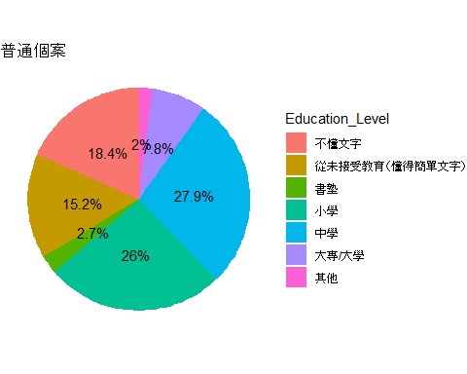
## # A tibble: 672 × 638
## num A1 A2a A2b A2c A3a A3b A3c B1 B2 B3 B4a B4b
## <int> <chr> <int> <int> <int> <int> <int> <int> <chr> <chr> <int> <int> <int>
## 1 631 EHC/… 2023 11 7 2025 5 7 " 陳駿… CHAN… 1 1938 1
## 2 58 EHC/… 2020 6 22 2024 6 17 "任煥娥… Yam … 2 1936 1
## 3 266 HSS/… 2024 12 27 2024 12 27 "伍瑞鳳… Ng S… 2 1943 11
## 4 59 EHC/… 2019 10 19 2024 6 27 "何亞蘭… Ho A… 2 1945 1
## 5 617 IHF/… 2025 6 27 2025 6 27 "余月容… YU Y… 2 1946 10
## 6 592 HSS/… 2025 5 28 2025 5 28 "冼家偉… Sin … 1 1929 1
## 7 26 HSS/… 2024 8 22 2024 8 22 "劉錞清… Lau … 1 1940 10
## 8 281 HSS/… 2010 9 14 2025 1 3 "古楊喜… Kuo … 1 1942 5
## 9 126 EHC/… 2019 10 21 2024 6 25 "吳鳳"… Ng F… 2 1933 1
## 10 628 EHC/… 2023 6 13 2025 5 16 "周猷光… CHOW… 1 1937 1
## # ℹ 662 more rows
## # ℹ 625 more variables: B4c <int>, B5 <int>, B6 <int>, B8a <chr>, B8b <chr>,
## # B8c <chr>, B11 <int>, B12 <int>, B12a <chr>, B13 <int>, B13a <chr>,
## # B14 <chr>, B15 <int>, B16 <int>, B16a <int>, B17 <int>, C1 <int>,
## # C1a <chr>, C2 <int>, C3 <int>, C3a <chr>, C4 <int>, C4a <int>, C5 <int>,
## # C6a <int>, C6b <int>, C6c <int>, C6d <int>, C6e <int>, C6e1 <chr>,
## # C7 <int>, C7a <int>, C7b <int>, C8 <int>, C8a <int>, C8b <int>, …
## # A tibble: 18 × 3
## A1_short Education_Level Frequency
## <chr> <int> <int>
## 1 EHC 0 59
## 2 EHC 3 41
## 3 EHC 4 31
## 4 EHC 1 28
## 5 EHC 2 11
## 6 EHC 5 10
## 7 HSS 4 114
## 8 HSS 3 106
## 9 HSS 0 75
## 10 HSS 1 62
## 11 HSS 5 32
## 12 HSS 2 11
## 13 HSS 6 8
## 14 IHF 0 30
## 15 IHF 3 25
## 16 IHF 4 16
## 17 IHF 1 10
## 18 IHF 5 3

Slide 7
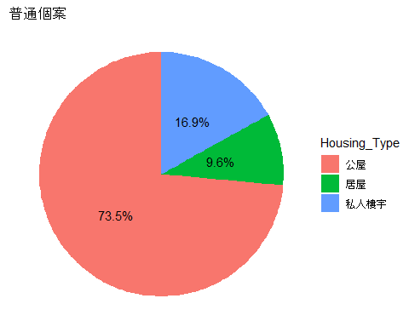
Demographics (Baseline = 672)
## # A tibble: 672 × 638
## num A1 A2a A2b A2c A3a A3b A3c B1 B2 B3 B4a B4b
## <int> <chr> <int> <int> <int> <int> <int> <int> <chr> <chr> <int> <int> <int>
## 1 631 EHC/… 2023 11 7 2025 5 7 " 陳駿… CHAN… 1 1938 1
## 2 58 EHC/… 2020 6 22 2024 6 17 "任煥娥… Yam … 2 1936 1
## 3 266 HSS/… 2024 12 27 2024 12 27 "伍瑞鳳… Ng S… 2 1943 11
## 4 59 EHC/… 2019 10 19 2024 6 27 "何亞蘭… Ho A… 2 1945 1
## 5 617 IHF/… 2025 6 27 2025 6 27 "余月容… YU Y… 2 1946 10
## 6 592 HSS/… 2025 5 28 2025 5 28 "冼家偉… Sin … 1 1929 1
## 7 26 HSS/… 2024 8 22 2024 8 22 "劉錞清… Lau … 1 1940 10
## 8 281 HSS/… 2010 9 14 2025 1 3 "古楊喜… Kuo … 1 1942 5
## 9 126 EHC/… 2019 10 21 2024 6 25 "吳鳳"… Ng F… 2 1933 1
## 10 628 EHC/… 2023 6 13 2025 5 16 "周猷光… CHOW… 1 1937 1
## # ℹ 662 more rows
## # ℹ 625 more variables: B4c <int>, B5 <int>, B6 <int>, B8a <chr>, B8b <chr>,
## # B8c <chr>, B11 <int>, B12 <int>, B12a <chr>, B13 <int>, B13a <chr>,
## # B14 <chr>, B15 <int>, B16 <int>, B16a <int>, B17 <int>, C1 <int>,
## # C1a <chr>, C2 <int>, C3 <int>, C3a <chr>, C4 <int>, C4a <int>, C5 <int>,
## # C6a <int>, C6b <int>, C6c <int>, C6d <int>, C6e <int>, C6e1 <chr>,
## # C7 <int>, C7a <int>, C7b <int>, C8 <int>, C8a <int>, C8b <int>, …
## # A tibble: 12 × 3
## A1_short Housing_Type Frequency
## <chr> <int> <int>
## 1 EHC 1 102
## 2 EHC 3 56
## 3 EHC 2 17
## 4 EHC 4 3
## 5 EHC 5 2
## 6 HSS 1 300
## 7 HSS 3 69
## 8 HSS 2 39
## 9 IHF 1 54
## 10 IHF 3 18
## 11 IHF 2 11
## 12 IHF 4 1

Slide 8
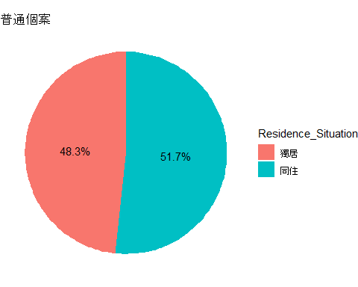
## # A tibble: 672 × 638
## num A1 A2a A2b A2c A3a A3b A3c B1 B2 B3 B4a B4b
## <int> <chr> <int> <int> <int> <int> <int> <int> <chr> <chr> <int> <int> <int>
## 1 631 EHC/… 2023 11 7 2025 5 7 " 陳駿… CHAN… 1 1938 1
## 2 58 EHC/… 2020 6 22 2024 6 17 "任煥娥… Yam … 2 1936 1
## 3 266 HSS/… 2024 12 27 2024 12 27 "伍瑞鳳… Ng S… 2 1943 11
## 4 59 EHC/… 2019 10 19 2024 6 27 "何亞蘭… Ho A… 2 1945 1
## 5 617 IHF/… 2025 6 27 2025 6 27 "余月容… YU Y… 2 1946 10
## 6 592 HSS/… 2025 5 28 2025 5 28 "冼家偉… Sin … 1 1929 1
## 7 26 HSS/… 2024 8 22 2024 8 22 "劉錞清… Lau … 1 1940 10
## 8 281 HSS/… 2010 9 14 2025 1 3 "古楊喜… Kuo … 1 1942 5
## 9 126 EHC/… 2019 10 21 2024 6 25 "吳鳳"… Ng F… 2 1933 1
## 10 628 EHC/… 2023 6 13 2025 5 16 "周猷光… CHOW… 1 1937 1
## # ℹ 662 more rows
## # ℹ 625 more variables: B4c <int>, B5 <int>, B6 <int>, B8a <chr>, B8b <chr>,
## # B8c <chr>, B11 <int>, B12 <int>, B12a <chr>, B13 <int>, B13a <chr>,
## # B14 <chr>, B15 <int>, B16 <int>, B16a <int>, B17 <int>, C1 <int>,
## # C1a <chr>, C2 <int>, C3 <int>, C3a <chr>, C4 <int>, C4a <int>, C5 <int>,
## # C6a <int>, C6b <int>, C6c <int>, C6d <int>, C6e <int>, C6e1 <chr>,
## # C7 <int>, C7a <int>, C7b <int>, C8 <int>, C8a <int>, C8b <int>, …
## # A tibble: 6 × 3
## A1_short Residence_Situation Frequency
## <chr> <int> <int>
## 1 EHC 2 159
## 2 EHC 1 21
## 3 HSS 2 211
## 4 HSS 1 197
## 5 IHF 2 73
## 6 IHF 1 11

Slide 9
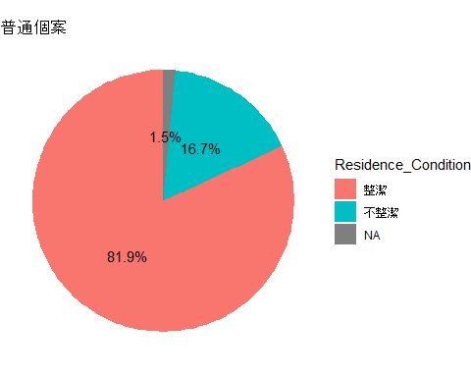
## # A tibble: 672 × 638
## num A1 A2a A2b A2c A3a A3b A3c B1 B2 B3 B4a B4b
## <int> <chr> <int> <int> <int> <int> <int> <int> <chr> <chr> <int> <int> <int>
## 1 631 EHC/… 2023 11 7 2025 5 7 " 陳駿… CHAN… 1 1938 1
## 2 58 EHC/… 2020 6 22 2024 6 17 "任煥娥… Yam … 2 1936 1
## 3 266 HSS/… 2024 12 27 2024 12 27 "伍瑞鳳… Ng S… 2 1943 11
## 4 59 EHC/… 2019 10 19 2024 6 27 "何亞蘭… Ho A… 2 1945 1
## 5 617 IHF/… 2025 6 27 2025 6 27 "余月容… YU Y… 2 1946 10
## 6 592 HSS/… 2025 5 28 2025 5 28 "冼家偉… Sin … 1 1929 1
## 7 26 HSS/… 2024 8 22 2024 8 22 "劉錞清… Lau … 1 1940 10
## 8 281 HSS/… 2010 9 14 2025 1 3 "古楊喜… Kuo … 1 1942 5
## 9 126 EHC/… 2019 10 21 2024 6 25 "吳鳳"… Ng F… 2 1933 1
## 10 628 EHC/… 2023 6 13 2025 5 16 "周猷光… CHOW… 1 1937 1
## # ℹ 662 more rows
## # ℹ 625 more variables: B4c <int>, B5 <int>, B6 <int>, B8a <chr>, B8b <chr>,
## # B8c <chr>, B11 <int>, B12 <int>, B12a <chr>, B13 <int>, B13a <chr>,
## # B14 <chr>, B15 <int>, B16 <int>, B16a <int>, B17 <int>, C1 <int>,
## # C1a <chr>, C2 <int>, C3 <int>, C3a <chr>, C4 <int>, C4a <int>, C5 <int>,
## # C6a <int>, C6b <int>, C6c <int>, C6d <int>, C6e <int>, C6e1 <chr>,
## # C7 <int>, C7a <int>, C7b <int>, C8 <int>, C8a <int>, C8b <int>, …
## # A tibble: 10 × 3
## A1_short Residence_Condition Frequency
## <chr> <int> <int>
## 1 EHC 1 162
## 2 EHC 2 15
## 3 EHC 0 3
## 4 HSS 1 334
## 5 HSS 2 68
## 6 HSS 0 5
## 7 HSS 998 1
## 8 IHF 1 74
## 9 IHF 2 9
## 10 IHF 0 1

Slide 10
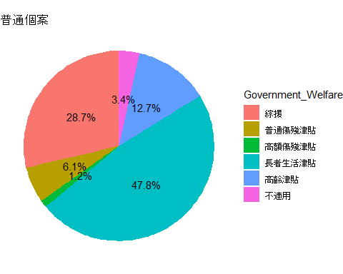
## # A tibble: 672 × 638
## num A1 A2a A2b A2c A3a A3b A3c B1 B2 B3 B4a B4b
## <int> <chr> <int> <int> <int> <int> <int> <int> <chr> <chr> <int> <int> <int>
## 1 631 EHC/… 2023 11 7 2025 5 7 " 陳駿… CHAN… 1 1938 1
## 2 58 EHC/… 2020 6 22 2024 6 17 "任煥娥… Yam … 2 1936 1
## 3 266 HSS/… 2024 12 27 2024 12 27 "伍瑞鳳… Ng S… 2 1943 11
## 4 59 EHC/… 2019 10 19 2024 6 27 "何亞蘭… Ho A… 2 1945 1
## 5 617 IHF/… 2025 6 27 2025 6 27 "余月容… YU Y… 2 1946 10
## 6 592 HSS/… 2025 5 28 2025 5 28 "冼家偉… Sin … 1 1929 1
## 7 26 HSS/… 2024 8 22 2024 8 22 "劉錞清… Lau … 1 1940 10
## 8 281 HSS/… 2010 9 14 2025 1 3 "古楊喜… Kuo … 1 1942 5
## 9 126 EHC/… 2019 10 21 2024 6 25 "吳鳳"… Ng F… 2 1933 1
## 10 628 EHC/… 2023 6 13 2025 5 16 "周猷光… CHOW… 1 1937 1
## # ℹ 662 more rows
## # ℹ 625 more variables: B4c <int>, B5 <int>, B6 <int>, B8a <chr>, B8b <chr>,
## # B8c <chr>, B11 <int>, B12 <int>, B12a <chr>, B13 <int>, B13a <chr>,
## # B14 <chr>, B15 <int>, B16 <int>, B16a <int>, B17 <int>, C1 <int>,
## # C1a <chr>, C2 <int>, C3 <int>, C3a <chr>, C4 <int>, C4a <int>, C5 <int>,
## # C6a <int>, C6b <int>, C6c <int>, C6d <int>, C6e <int>, C6e1 <chr>,
## # C7 <int>, C7a <int>, C7b <int>, C8 <int>, C8a <int>, C8b <int>, …
## # A tibble: 18 × 3
## A1_short Government_Welfare Frequency
## <chr> <int> <int>
## 1 EHC 4 98
## 2 EHC 5 28
## 3 EHC 1 23
## 4 EHC 3 13
## 5 EHC 2 12
## 6 EHC 998 5
## 7 EHC 999 1
## 8 HSS 4 195
## 9 HSS 1 117
## 10 HSS 5 52
## 11 HSS 2 25
## 12 HSS 998 14
## 13 HSS 3 5
## 14 IHF 4 45
## 15 IHF 5 18
## 16 IHF 1 12
## 17 IHF 3 6
## 18 IHF 2 3

Slide 11
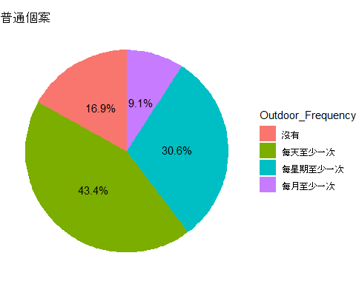
## # A tibble: 672 × 638
## num A1 A2a A2b A2c A3a A3b A3c B1 B2 B3 B4a B4b
## <int> <chr> <int> <int> <int> <int> <int> <int> <chr> <chr> <int> <int> <int>
## 1 631 EHC/… 2023 11 7 2025 5 7 " 陳駿… CHAN… 1 1938 1
## 2 58 EHC/… 2020 6 22 2024 6 17 "任煥娥… Yam … 2 1936 1
## 3 266 HSS/… 2024 12 27 2024 12 27 "伍瑞鳳… Ng S… 2 1943 11
## 4 59 EHC/… 2019 10 19 2024 6 27 "何亞蘭… Ho A… 2 1945 1
## 5 617 IHF/… 2025 6 27 2025 6 27 "余月容… YU Y… 2 1946 10
## 6 592 HSS/… 2025 5 28 2025 5 28 "冼家偉… Sin … 1 1929 1
## 7 26 HSS/… 2024 8 22 2024 8 22 "劉錞清… Lau … 1 1940 10
## 8 281 HSS/… 2010 9 14 2025 1 3 "古楊喜… Kuo … 1 1942 5
## 9 126 EHC/… 2019 10 21 2024 6 25 "吳鳳"… Ng F… 2 1933 1
## 10 628 EHC/… 2023 6 13 2025 5 16 "周猷光… CHOW… 1 1937 1
## # ℹ 662 more rows
## # ℹ 625 more variables: B4c <int>, B5 <int>, B6 <int>, B8a <chr>, B8b <chr>,
## # B8c <chr>, B11 <int>, B12 <int>, B12a <chr>, B13 <int>, B13a <chr>,
## # B14 <chr>, B15 <int>, B16 <int>, B16a <int>, B17 <int>, C1 <int>,
## # C1a <chr>, C2 <int>, C3 <int>, C3a <chr>, C4 <int>, C4a <int>, C5 <int>,
## # C6a <int>, C6b <int>, C6c <int>, C6d <int>, C6e <int>, C6e1 <chr>,
## # C7 <int>, C7a <int>, C7b <int>, C8 <int>, C8a <int>, C8b <int>, …
## # A tibble: 12 × 3
## A1_short Outdoor_Frequency Frequency
## <chr> <int> <int>
## 1 EHC 1 69
## 2 EHC 2 55
## 3 EHC 0 39
## 4 EHC 3 17
## 5 HSS 1 177
## 6 HSS 2 125
## 7 HSS 0 69
## 8 HSS 3 37
## 9 IHF 2 33
## 10 IHF 1 31
## 11 IHF 0 10
## 12 IHF 3 10

Slide 12
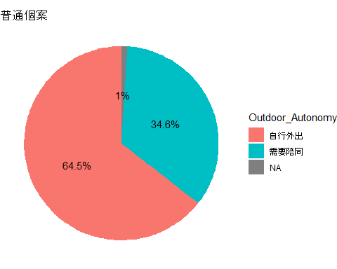
## # A tibble: 672 × 638
## num A1 A2a A2b A2c A3a A3b A3c B1 B2 B3 B4a B4b
## <int> <chr> <int> <int> <int> <int> <int> <int> <chr> <chr> <int> <int> <int>
## 1 631 EHC/… 2023 11 7 2025 5 7 " 陳駿… CHAN… 1 1938 1
## 2 58 EHC/… 2020 6 22 2024 6 17 "任煥娥… Yam … 2 1936 1
## 3 266 HSS/… 2024 12 27 2024 12 27 "伍瑞鳳… Ng S… 2 1943 11
## 4 59 EHC/… 2019 10 19 2024 6 27 "何亞蘭… Ho A… 2 1945 1
## 5 617 IHF/… 2025 6 27 2025 6 27 "余月容… YU Y… 2 1946 10
## 6 592 HSS/… 2025 5 28 2025 5 28 "冼家偉… Sin … 1 1929 1
## 7 26 HSS/… 2024 8 22 2024 8 22 "劉錞清… Lau … 1 1940 10
## 8 281 HSS/… 2010 9 14 2025 1 3 "古楊喜… Kuo … 1 1942 5
## 9 126 EHC/… 2019 10 21 2024 6 25 "吳鳳"… Ng F… 2 1933 1
## 10 628 EHC/… 2023 6 13 2025 5 16 "周猷光… CHOW… 1 1937 1
## # ℹ 662 more rows
## # ℹ 625 more variables: B4c <int>, B5 <int>, B6 <int>, B8a <chr>, B8b <chr>,
## # B8c <chr>, B11 <int>, B12 <int>, B12a <chr>, B13 <int>, B13a <chr>,
## # B14 <chr>, B15 <int>, B16 <int>, B16a <int>, B17 <int>, C1 <int>,
## # C1a <chr>, C2 <int>, C3 <int>, C3a <chr>, C4 <int>, C4a <int>, C5 <int>,
## # C6a <int>, C6b <int>, C6c <int>, C6d <int>, C6e <int>, C6e1 <chr>,
## # C7 <int>, C7a <int>, C7b <int>, C8 <int>, C8a <int>, C8b <int>, …
## # A tibble: 8 × 3
## A1_short Outdoor_Autonomy Frequency
## <chr> <int> <int>
## 1 EHC 2 143
## 2 EHC 1 33
## 3 EHC 0 4
## 4 HSS 1 263
## 5 HSS 2 141
## 6 HSS 0 4
## 7 IHF 2 65
## 8 IHF 1 19

Slide 13
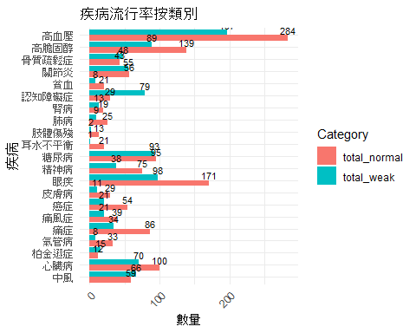
Disease Prevalence (Baseline = 672)
## Warning: package 'tidyr' was built under R version 4.5.2

